Slide 1


Online Employee Payroll Management System
Submitted By
K.S School Of Business Management
Krupa Deria (3095)
Chandni Soni (3157)

Slide 2

Say Good Bye To Manual Payroll
An Online employee payroll Management System, is a system where employee can apply for leaves and admin/HR Manager can approve/reject leaves request.
Admin can Manage attendance of all employees and manage Payroll of all employee, managing shifts, allotting particular branch of the company to add new or existing employee.

Slide 3

Go Online (Unique Feature)
Online Chat:
Our System manages the messages to be delivered to the employees. Employees, at any level of designation, can chat or send a message to any other employee of company. If both the employees are online at same the time, they can give immediate response to each other. The advantage about this feature is that, any employee can solve the query by asking the particular employee.

Slide 4

We provide Easy to read Reports
Our detailed Report includes:-
Payroll Summary
Consolidated Report
Arrival / Departure Time
Holiday type
Absence/presence
Late out
Shifts

Slide 5

DATA DICTIONARY
Department
Shift
Designation
Branch
Holidays
Employee
Employee Attendance
Employee Leaves
Payroll
Payroll Details
Chat

Slide 6
Department
Field Name | Data type | Size | Constrain | Description
Department_id | INT | 5 | PRIMARY KEY | ID of department
Department_name | VARCHAR | 20 | NOT NULL | Name of department
Created_date | DATE |  | NOT NULL | Created date of entry
Modified_date | DATE |  | NOT NULL | Modified date of entry
Status | TINYINT | 1 | NOT NULL | Either Active or Inactive

Slide 7
Shift
Field Name | Data type | Size | Constrain | Description
Shift_id | INT | 5 | PRIMARY KEY | ID of particular shift
Shift_name | Char | 25 | NOT NULL | Name of shift
In_time | TIME |  | NOT NULL | Entrance time of employee
Out_time | TIME |  | NOT NULL | Leaving time of employee
Created_date | DATE |  | NOT NULL | Created date of entry
Modified_date | DATE |  | NOT NULL | Modified date of entry
Status | TINYINT | 1 | NOT NULL | Either active or Inactive

Slide 8
Designation
Field Name | Data type | Size | Constrain | Description
Designation_id | INT | 5 | PRIMARY KEY | ID of designation
Designation_name | CHAR | 25 | NOT NULL | Name of designation
Super_id | INT | 5 | UNIQUE KEY | The ID which is superior
Super_id_name | CHAR | 25 | NOT NULL | Name of the employee who is superior to current employee
Created_date | DATE |  | NOT NULL | Created date of entry
Modified_date | DATE |  | NOT NULL | Modified date of entry
Status | TINYINT | 1 | NOT NULL | Either Active or Inactive

Slide 9
Branch
Field Name | Data type | Size | Constrain | Description
Bracnh_id | INT | 5 | PRIMARY KEY | ID of branch
Name | CHAR | 25 | NOT NULL | Name of branch
Branch_Address | VARCHAR | 100 | NOT NULL | Branch Address of company
Phone_number | BIGNT | 10 | NOT NULL | Phone number of branch
Email | VARCHAR | 40 |  | Official email of branch
Establishment_date | DATE |  | NOT NULL | Establishment date of branch
Created_by | CHAR | 25 | NOT NULL | Name of the one who logged in and adds new branch
Created_date | DATE |  | NOT NULL | Created date of entry
Modified_date | DATE |  | NOT NULL | Modified date of entry
Status | INT | 1 | NOT NULL | (Either Active or Inactive)

Slide 10
Holidays
Field Name | Data type | Size | Constrain | Description
Holiday_id | INT | 5 | PRIMARY KEY | ID for holiday
Holiday_name | CHAR | 30 | NOT NULL | Name of holiday
Holiday_description | VARCHAR | 50 |  | Description of holiday
Holiday_date | DATE |  | NOT NULL | Date on which holiday is to be taken
Created_date | DATE |  | NOT NULL | Created date of entry
Modified_date | DATE |  | NOT NULL | Modified date of entry
Status | TINYINT | 1 | NOT NULL | Either Active or Inactive

Slide 11
Employee
Field Name | Data type | Size | Constrain | Description
Employee_id | INT | 5 | PRIMARY KEY | ID of employee
Employee_Name | CHAR | 30 | NOT NULL | Name of employee
Current_address | VARCHAR | 80 | NOT NULL | Current address of employee
Permanent_address | VARCHAR | 80 | NOT NULL | Permanent address of employee
Mobile_number | BIGINT | 10 | NOT NULL | Mobile number of employee
Gender | CHAR | 10 | NOT NULL | MALE/FEMALE
Email | VARCHAR | 50 | NOT NULL | Email of employee
DOB | DATE |  | NOT NULL | Date of Birth
Qualification | VARCHAR | 20 |  | Qualification of employee
Joining_date | DATE |  | NOT NULL | Joining date of employee

Slide 12
Employee Cont.
Registration_date | DATE |  | NOT NULL | Registration date of company
Department_id | INT | 5 | FOREIGN KEY | ID of department
Bracnh_id | INT | 5 | FOREIGN KEY | ID of company
Designation_id | INT | 5 | FOREIGN KEY | ID of designation
Shift_id | INT | 5 | FOREIGN KEY | ID of shift
Password | VARCHAR | 20 | NOT NULL | Password to be entered while logging
Bank_account_number | BIGINT | 16 | UNIQUE KEY | Bank account number
PAN_number | VARCHAR | 10 | UNIQUE KEY | PAN number
Created_date | DATE |  | NOT NULL | Created date of entry
Modified_date | DATE |  | NOT NULL | Modified date of entry
Status | INT | 1 | NOT NULL | Either active or inactive
Confirm_password | VARCHAR | 20 | NOT NULL | Confirmation for password.

Slide 13
Employee Cont.
Roles | INT | 1 | NOT NULL | Role of employee whether he/she is admin ,manager , or other.
city | CHAR | 15 | NOT NULL | City name of employee.
img | LONGTEXT |  | NULL | Path of image will be stored.
Basic_salary | FLOAT | 10,3 | NOT NULL | Basic salary of employee.
PT | FLOAT | 8,3 | NOT NULL | Predefined amount of professional tax will be deducted from salary.

Slide 14
Employee Attendance
Field Name | Data type | Size | Constrain | Description
Employee_attendance_id | INT | 5 | PRIMARY KEY | ID of employee attendance
Employee_id | INT | 5 | NOT NULL | ID of employee
Bio_date | INT | 2 | NOT NULL | Date from 1 to 30
Checkin_time | TIME | 3 | NOT NULL | Time at which employee checks in
Checkout_time | TIME | 3 | NOT NULL | Time at which employee checks out

Slide 15
Employee leaves
Field Name | Data type | Size | Constrain | Description
Employeeleaves_id | INT | 5 | PRIMARY KEY | ID of employee leaves
Leaveday_type | CHAR | 12 | UNIQUE KEY | Full Day / First Half / Second Half
Leave_type | CHAR | 2 | NOT NULL | (Sick Leave(SL)/Casual Leave(CL))
Leave_from_date | DATE |  | NOT NULL | Date from which leave is taken
Leave_to_date | DATE |  | NOT NULL | Till which date leave is to be taken
Employee_id | INT | 5 | FOREIGN KEY | ID of employee
Action_taken_by_id | INT | 5 | UNIQUE KEY | ID of the person who takes action for leaves
Leave_reason_description | VARCHAR | 50 |  | Reason for leave
Leave_reject_reason_description | VARCHAR | 50 |  | Reason for rejecting the leave
Created_date | DATE | 3 | NOT NULL | Created date of entry
Modified_date | DATE | 3 | NOT NULL | Modified date of entry

Slide 16
Payroll
Field Name | Data type | Size | Constrain | Description
Payroll_id | INT | 5 | PRIMARY KEY | ID of payroll
Payroll_month | VARCHAR | 8 | NOT NULL | Month of payroll
Payroll_year | DATE | 3 | NOT NULL | Year of payroll
Employee_id | INT | 5 | FOREIGN KEY | ID of employee
Present_days | INT | 5 | NOT NULL | Present days of employee
Working_days | INT | 5 | NOT NULL | Working days of employee
Balance_leaves | INT | 5 | NOT NULL | Balance left for sick leaves

Slide 17
Payroll Details
Field Name | Data type | Size | Constrain | Description
Payroll_detial_id | INT | 5 | PRIMARY KEY | ID of payroll details
Employee_id | INT | 5 | FOREIGN KEY | ID of employee
Net_salary | FLOAT | 10,3 | NOT NULL | Net of employee
Bonus | FLOAT | 8,3 | NULL | Bonus of employee

Slide 18
CHAT
Field Name | Data type | Size | Constrain | Description
chat_id | INT | 5 | PRIMARY KEY | ID of chat.
from_id | INT | 5 | NOT NULL | ID of sender.
to_id | INT | 5 | NOT NULL | ID of receiver.
Message | VARCHAR | 500 | NOT NULL | Content to be sent and received.
Chattime | TIME |  | NOT NULL | Timings of conversation.
Status | TINYINT | 2 | NOT NULL | Either message read/unread.

Slide 19
Use Case

Slide 20
Class Diagram

Slide 21

GLIMPSES OF SYSTEM

Slide 22


Log in page

Slide 23
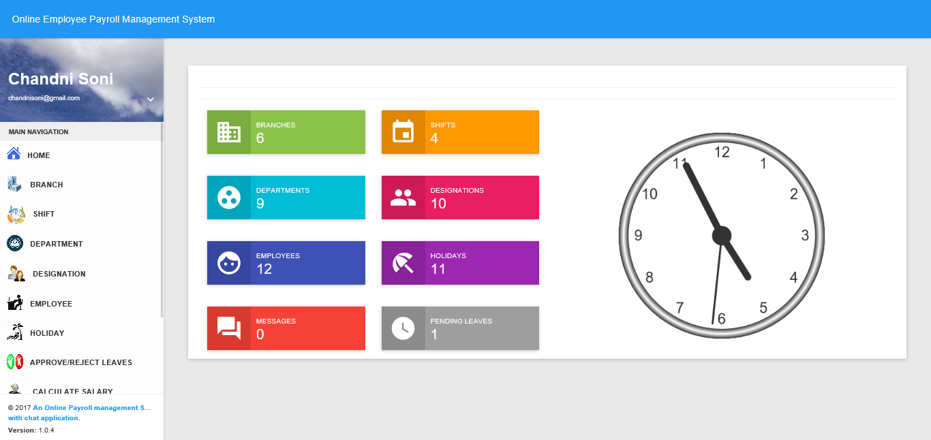
Home Page of Adminstrator

Slide 24
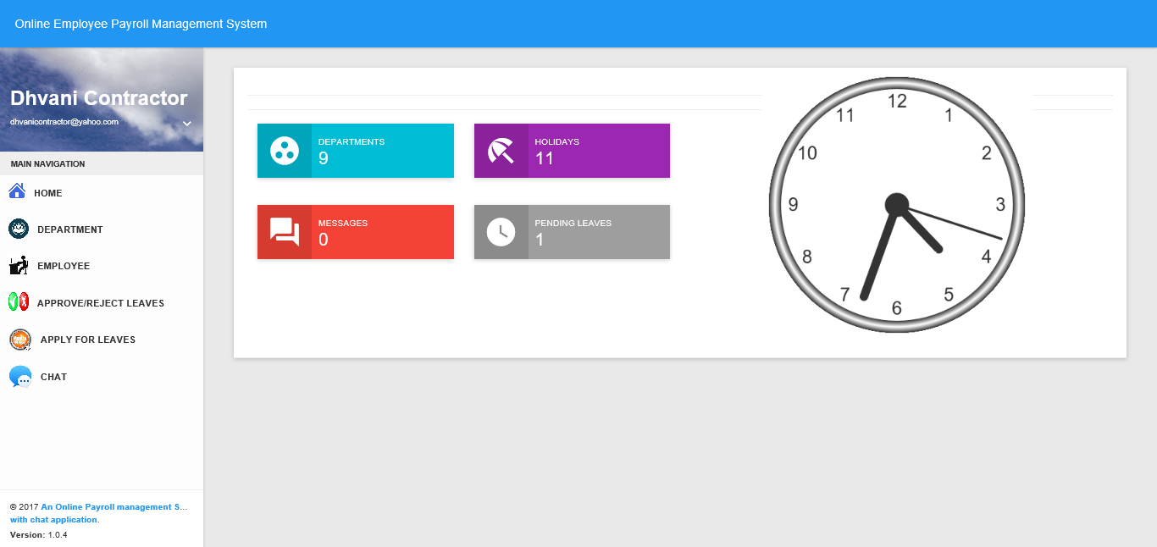
Home Page of Manager

Slide 25
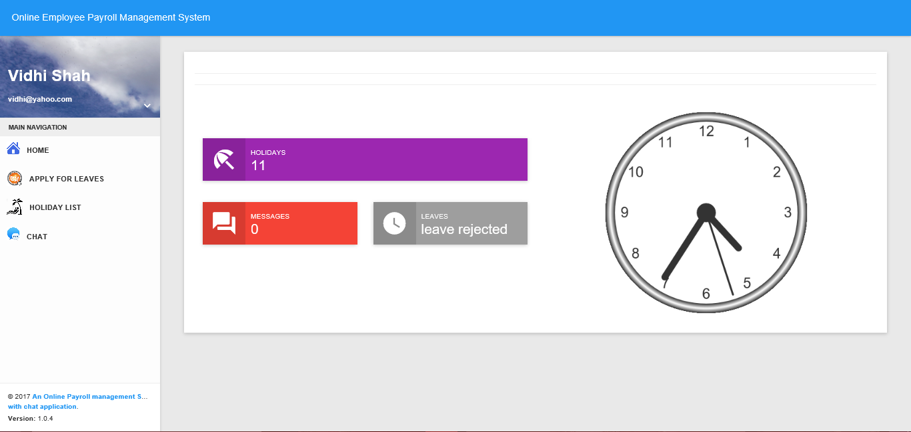
Home Page of Other Employee

Slide 26
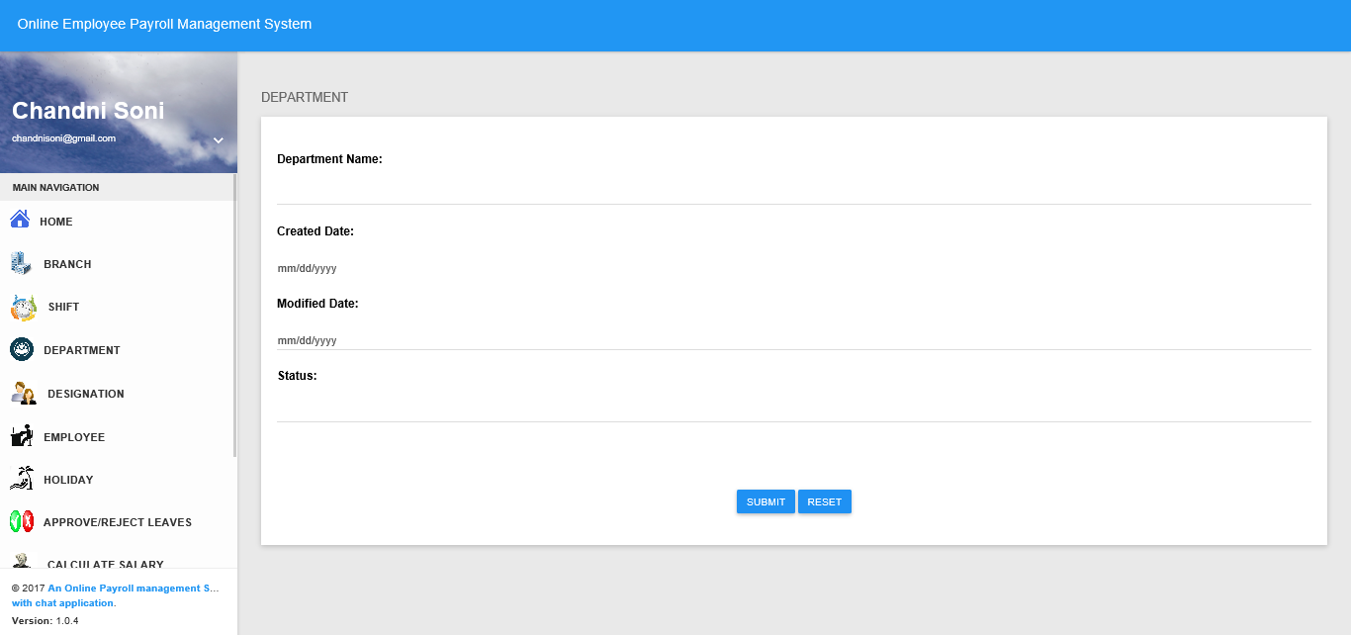
Department Add Page(Admin)

Slide 27
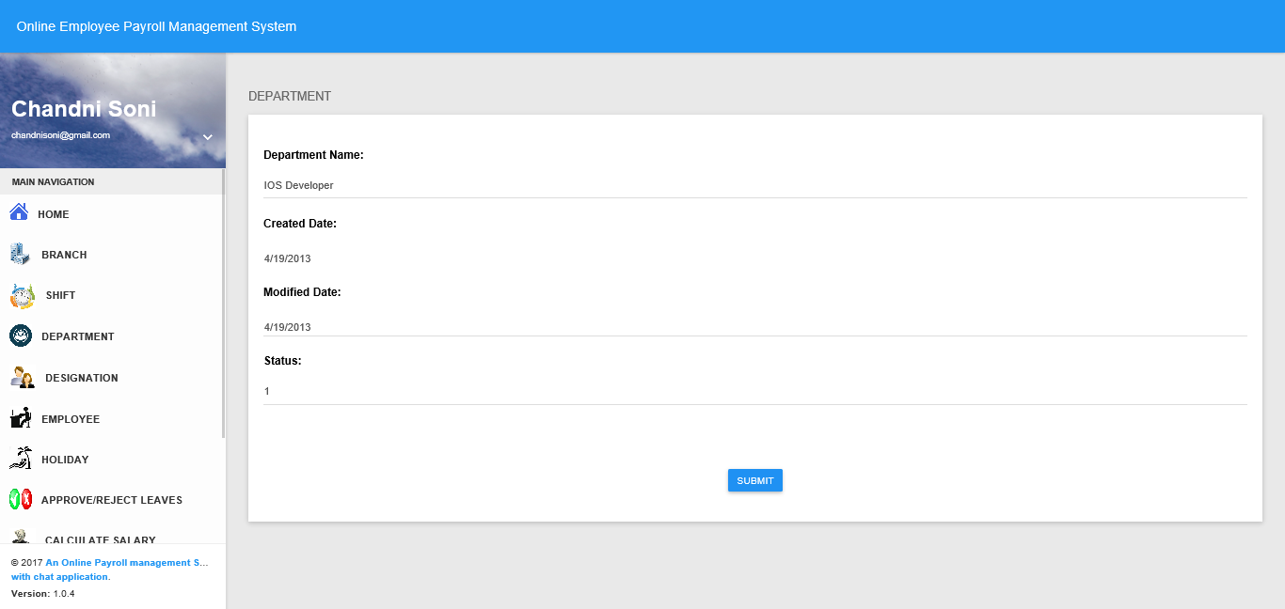
Department Update Page(Admin)

Slide 28
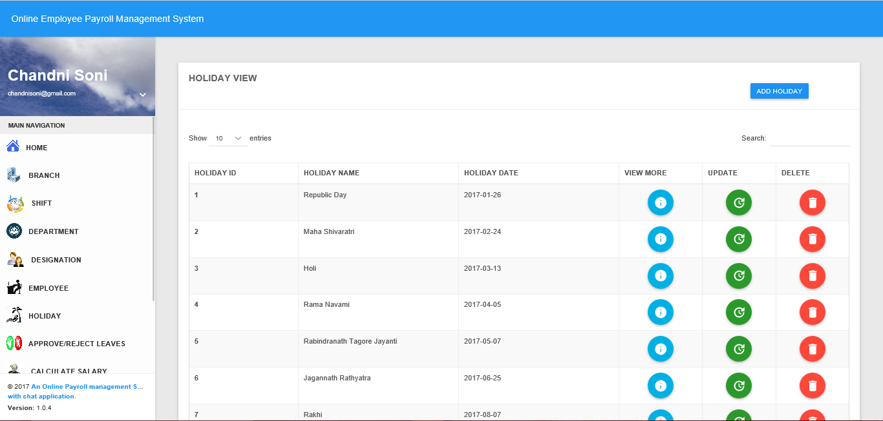
Holiday View(Admin)

Slide 29
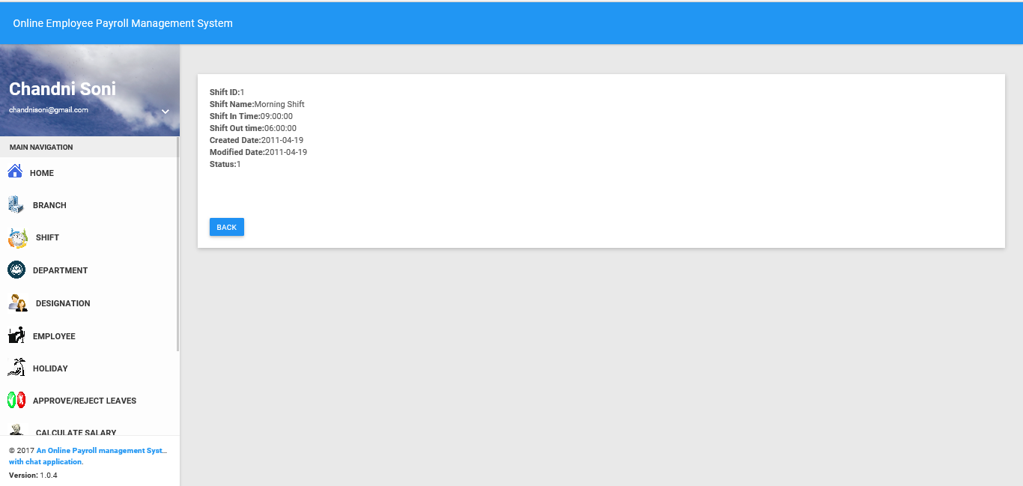
Shift View More(Admin)

Slide 30
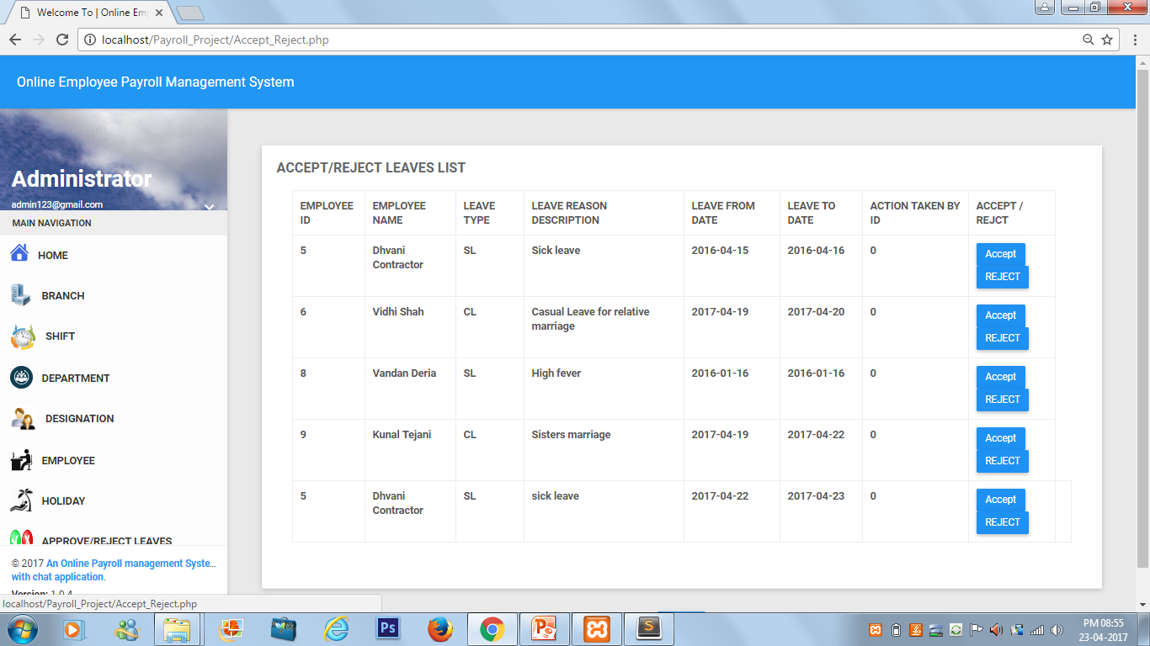
Accept/Reject Leaves List(Admin)

Slide 31
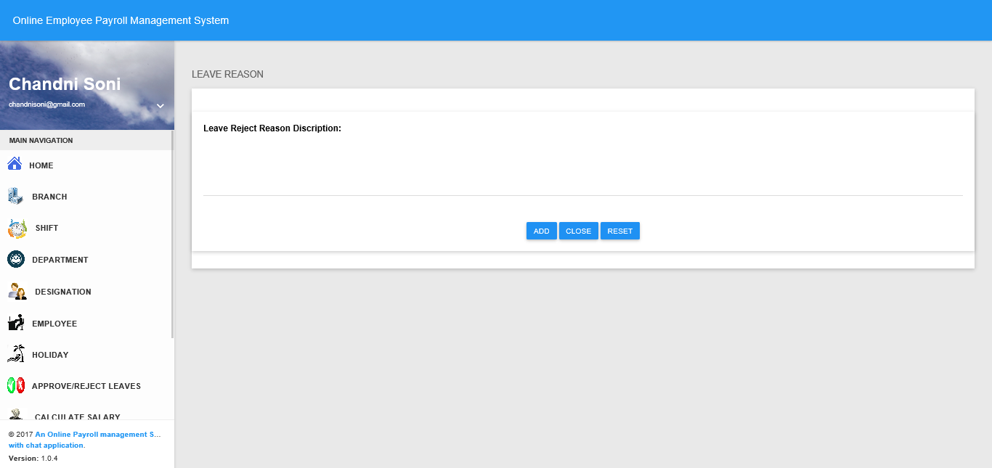
Leave Reject Description

Slide 32
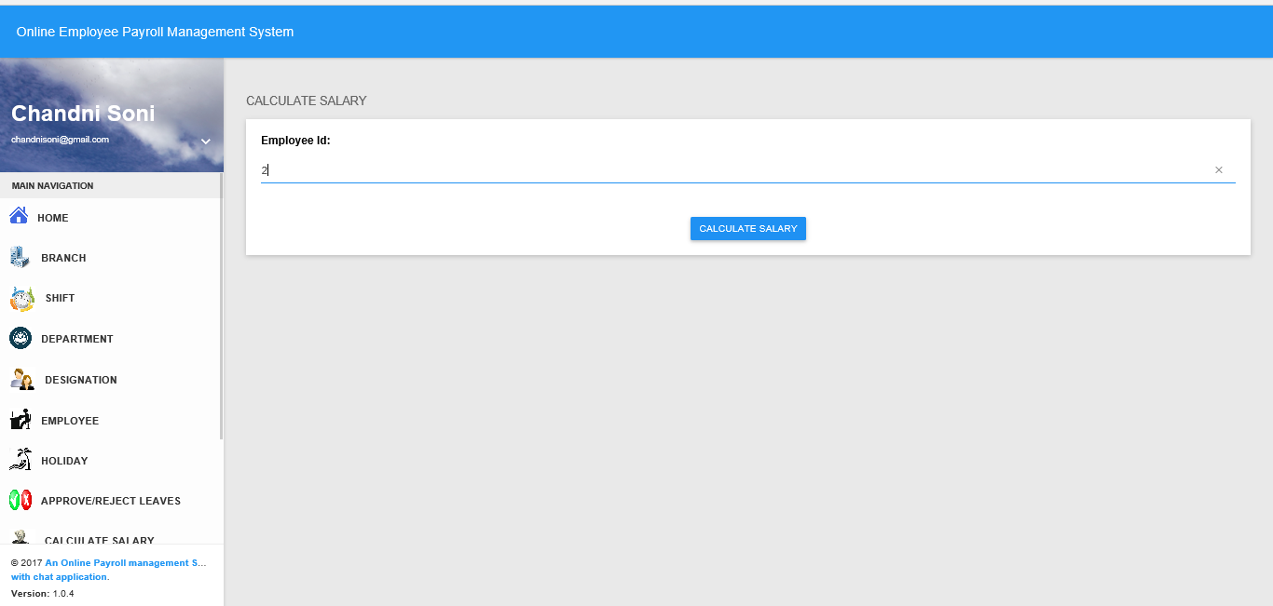
Calculate Salary(Admin)

Slide 33
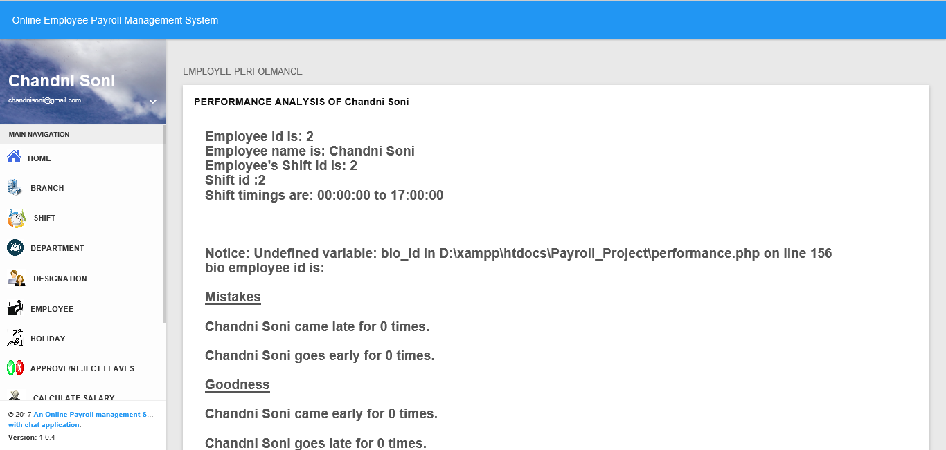
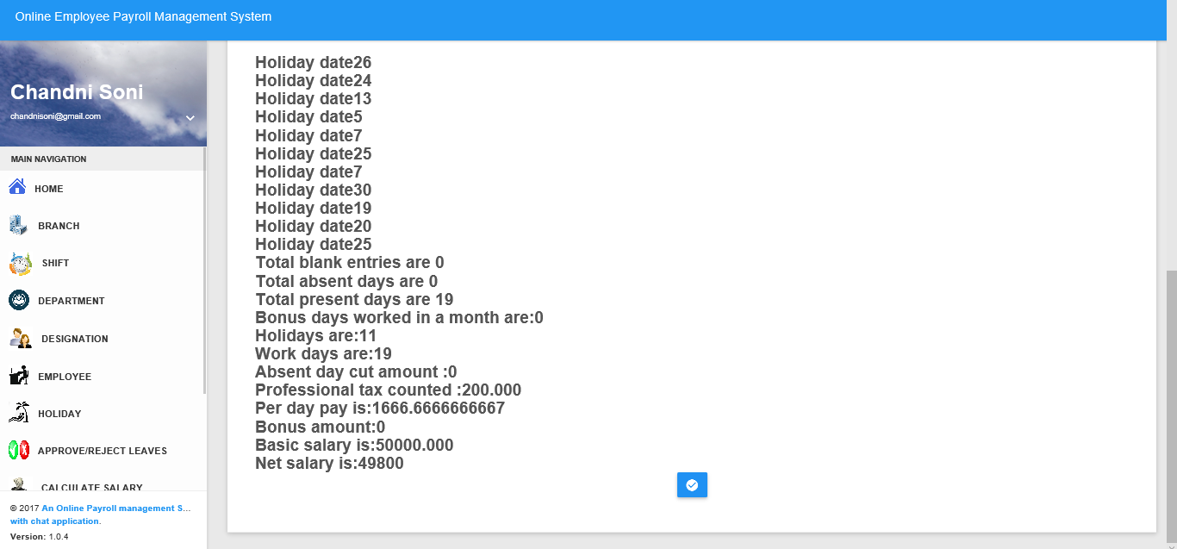
Performance Report of employee

Slide 34
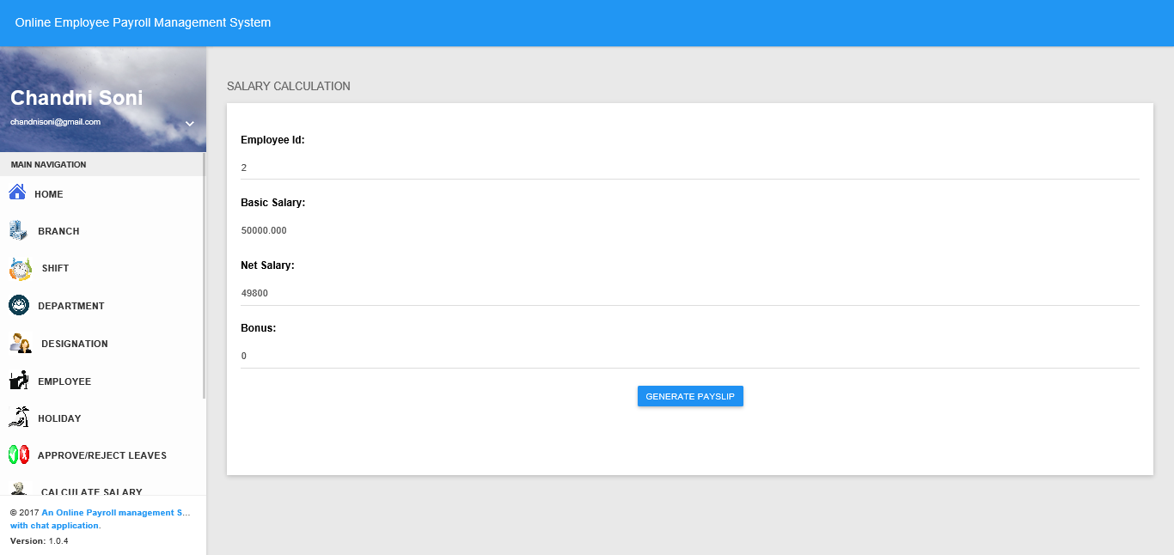
Salary Calculated

Slide 35
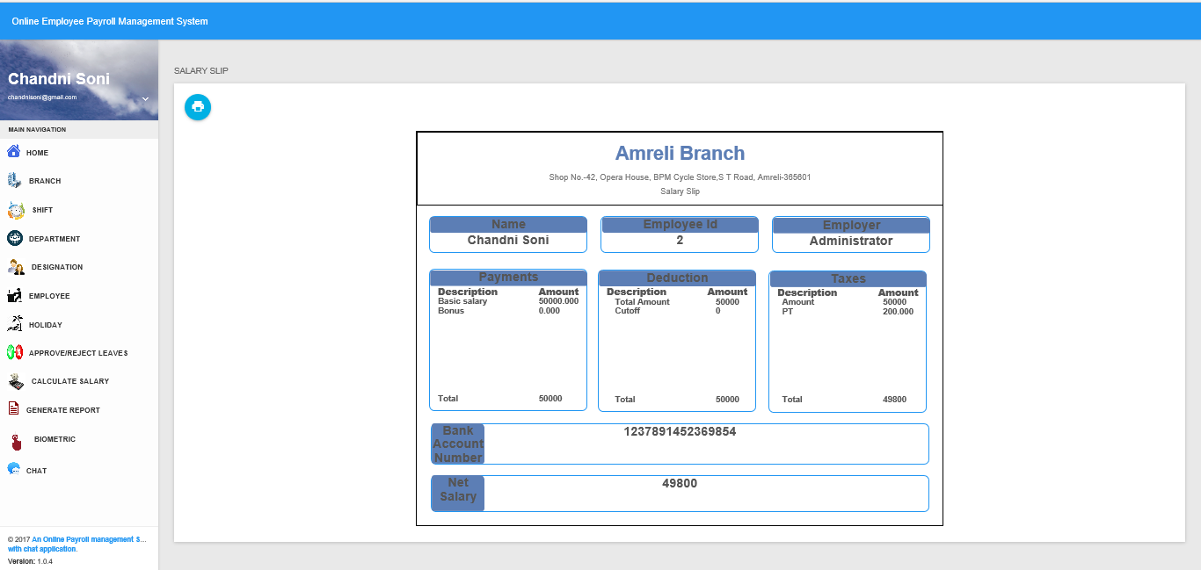
Payslip generated

Slide 36
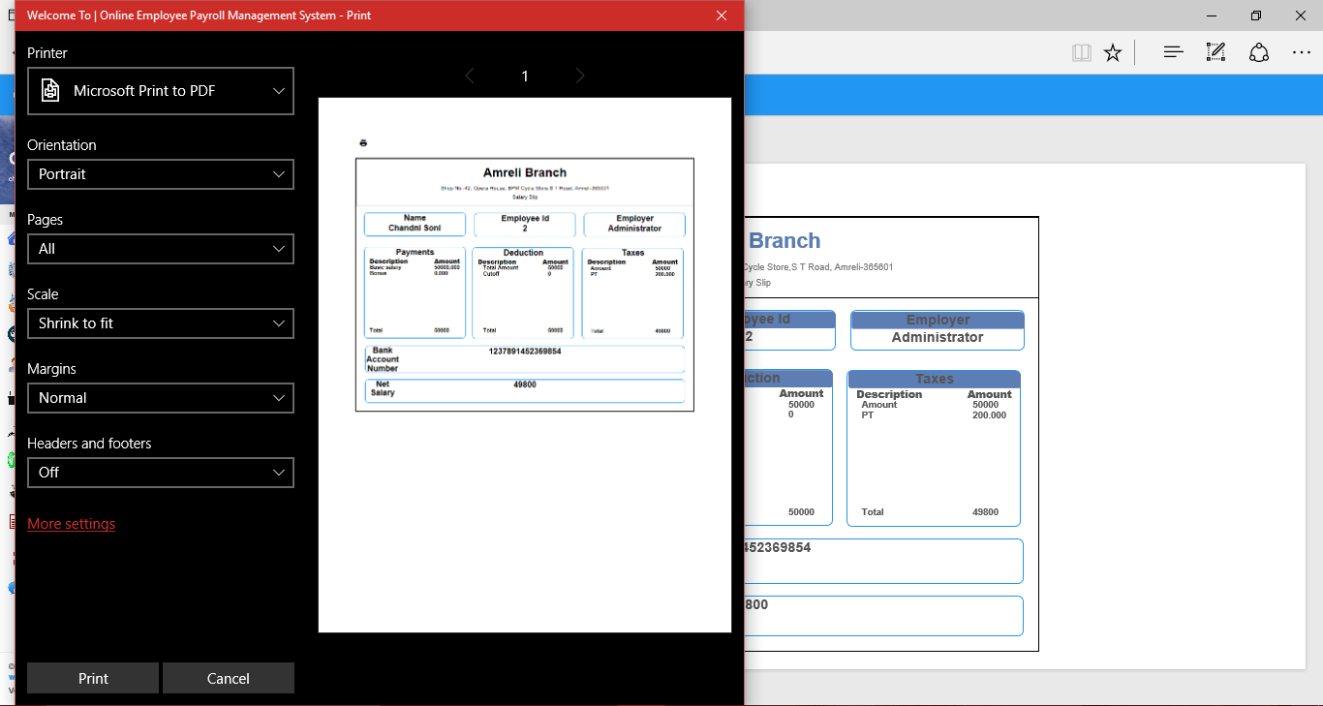
Generated Report(Print)

Slide 37
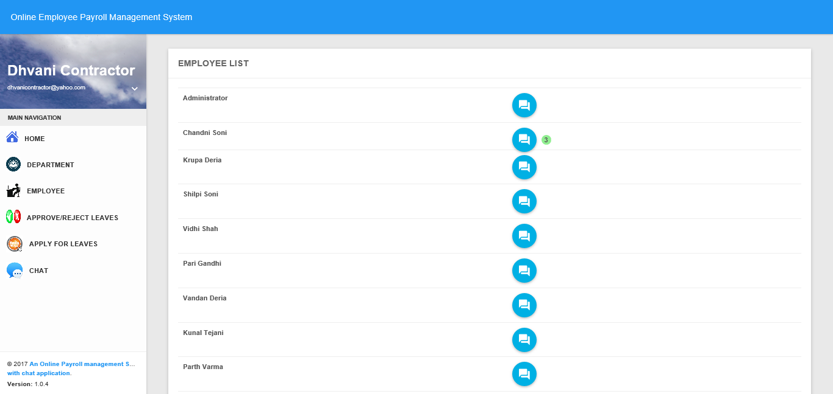
Employee List for chat

Slide 38
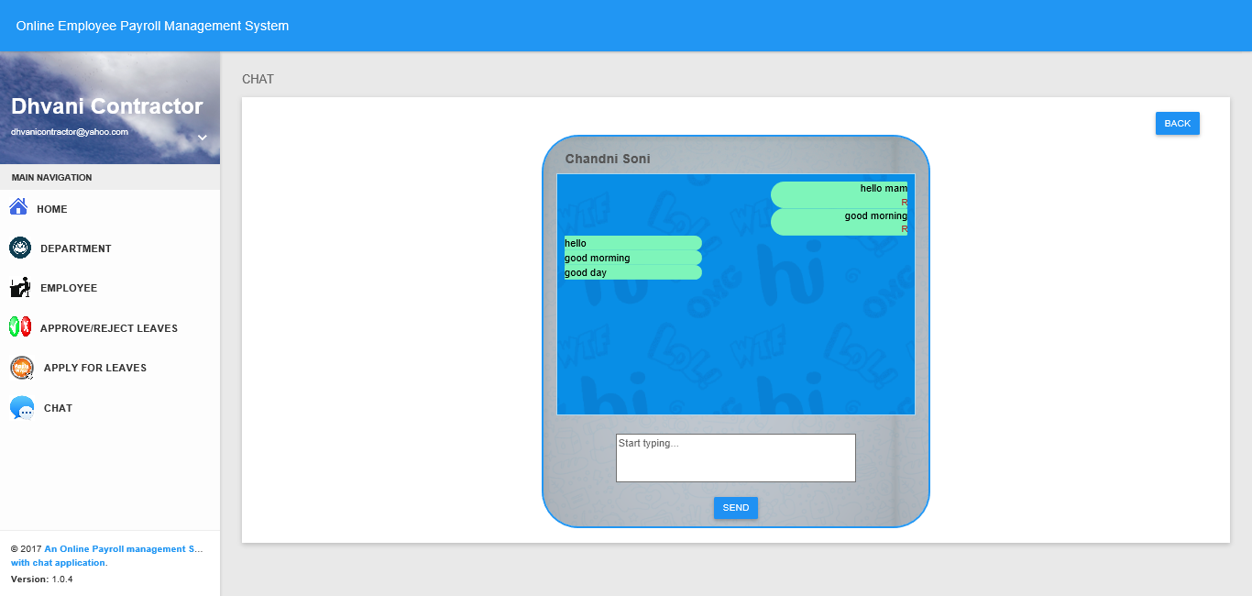
Chat Box

Slide 39
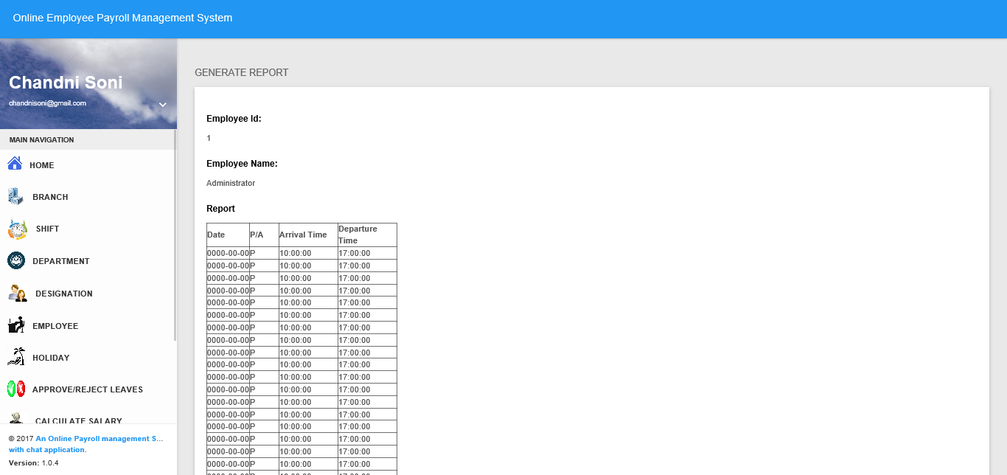
Generated Report

Slide 40
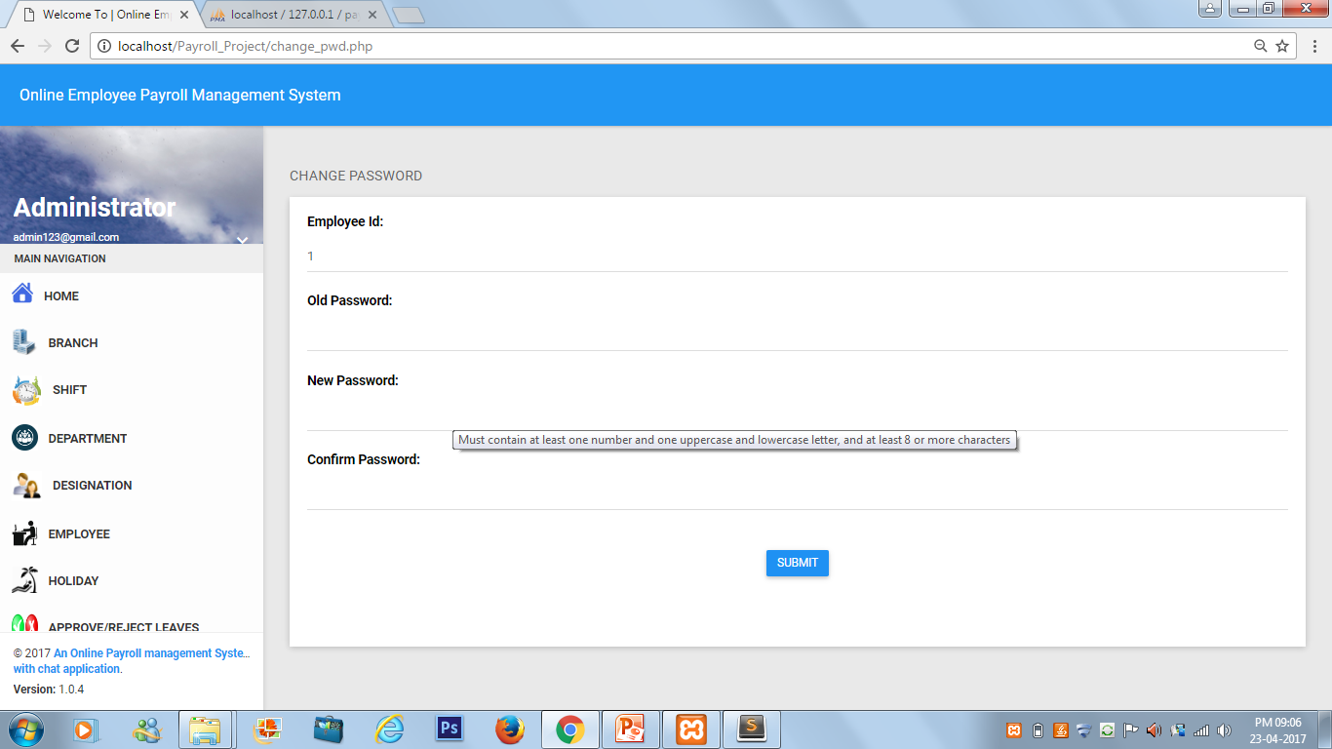
Change Password

Slide 41
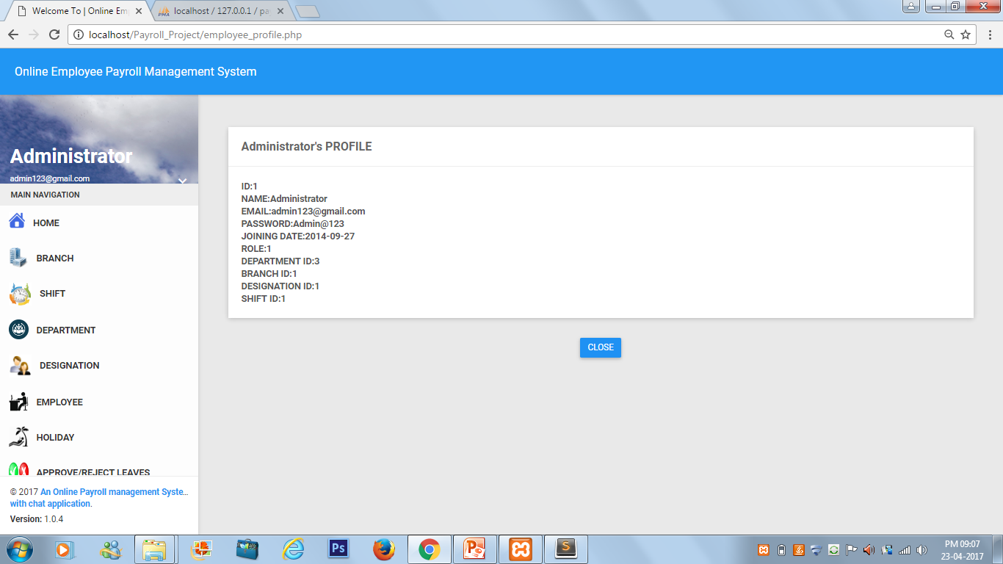
Admin Profile

Slide 42
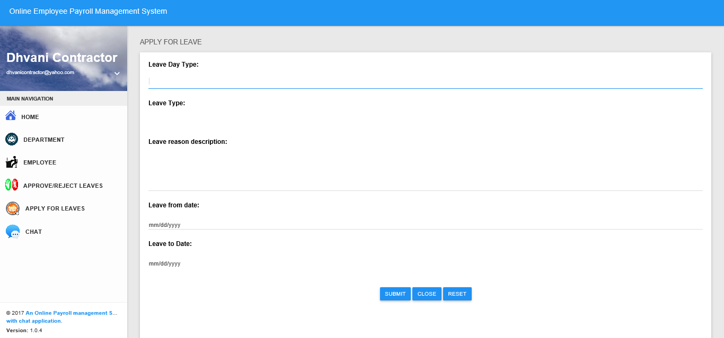
Apply for leave

Slide 43

DATA VALIDATIONS

Slide 44
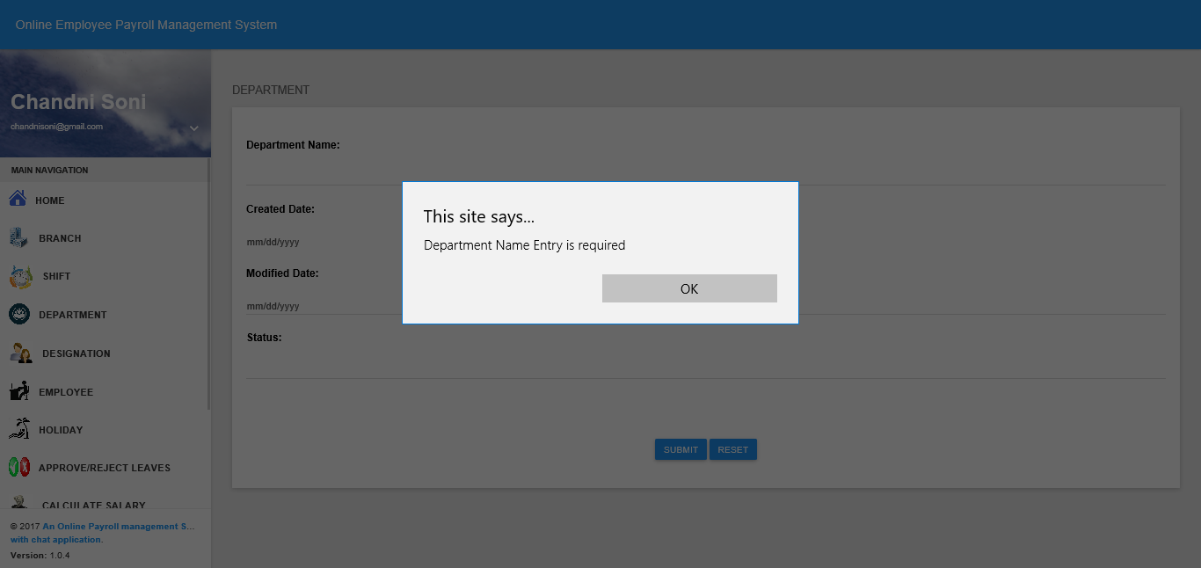
Validations(Glimpses)

Slide 45
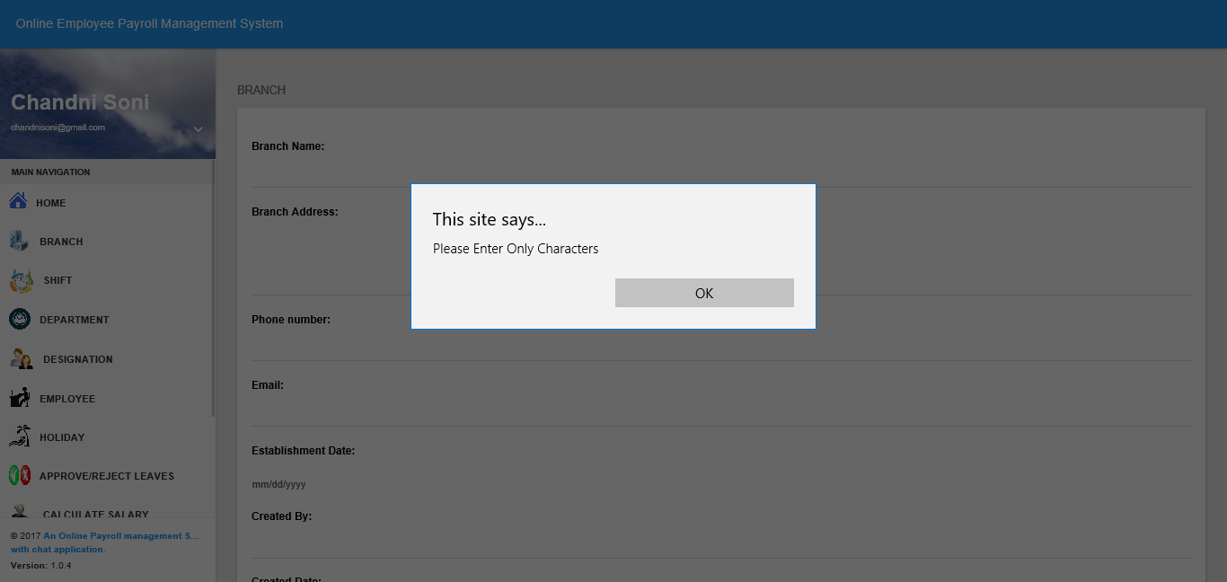
Validation

Slide 46
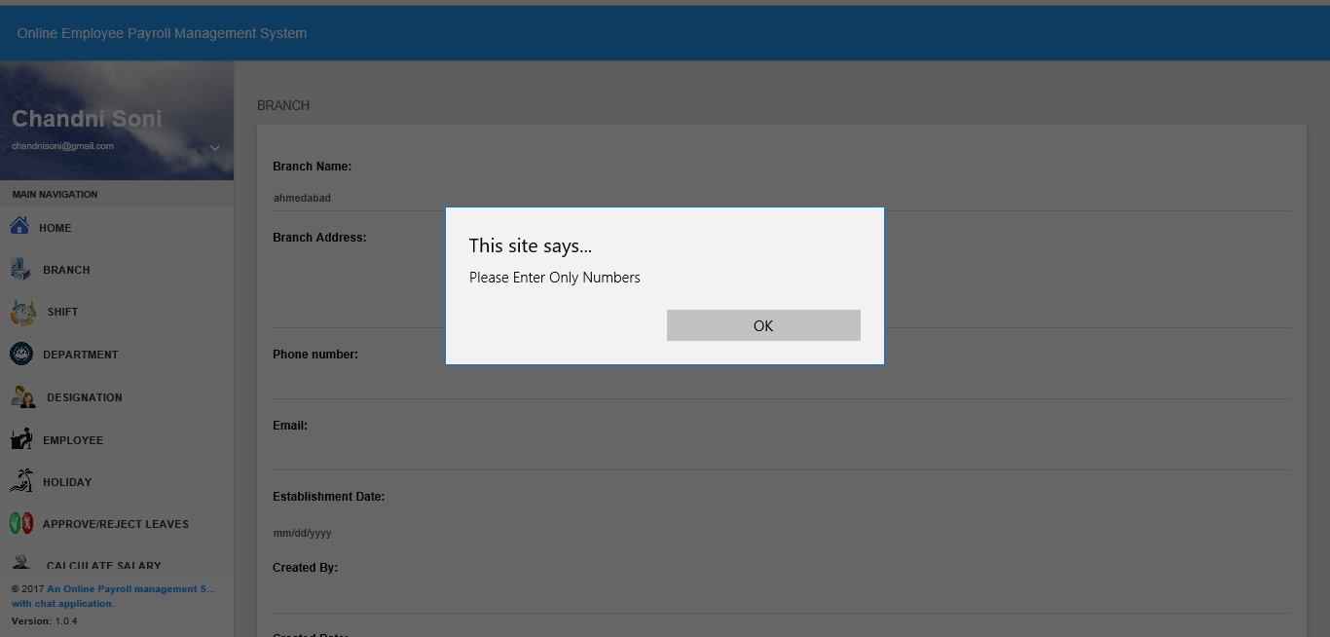
Validation

Slide 47

Conclusion
The main aim of project is to put what we learnt in our software engineering class into practice.
The application Payroll System developed by us has made the best possible efforts to satisfy the needs of Employee and Administrator.
The details can be accessed and the salary calculation is done according to the rules and regulations of company in shortest time frame and keep Employers up to date on his statutory obligations

Slide 48


